Slide 1

Roles & Responsibilities of Patients & Caregivers in Patient Safety
Presented by: Dr. Amit Ranjan, AIIMS Gorakhpur

Slide 2


Slide 3
Introduction to Patient Safety
WHO Definition:
The absence of preventable harm to a patient and reduction of risk of unnecessary harm associated with health care to an acceptable minimum.#
#https://www.who.int/news-room/fact-sheets/detail/patient-safety

Slide 4
Introduction to Patient Safety
Why Patient & Caregiver Engagement Matters:
Reduces medical errors
Improves communication
Enhances treatment adherence.

Slide 5

Patients’ Rights & Responsibilities

Slide 6
Patients’ Rights & Responsibilities (From NABH Patient Charter)
Rights:
Right to dignified & discrimination-free care
Right to privacy & confidentiality
Right to be informed about diagnosis, treatment options & risks
Right to seek second opinions & access medical records
Right to complaint redressal & fair hearing

Slide 7
Patients’ Rights & Responsibilities (From NABH Patient Charter)
Responsibilities:
Honest disclosure of medical history
Adherence to treatment plans
Respect for healthcare staff
Following hospital policies and safety protocols

Slide 8

Stakeholders Influencing Patient Safety
Patients & Family Members
Doctors & Nurses
Hospitals & Policy Makers
Diagnostics & Pharma Companies
Patient Support Groups & Insurance Providers

Slide 9

Barriers to Patient Involvement
Patients: Fear of offending doctors, lack of awareness.
Healthcare Professionals: Legal risks, workload issues.
Solutions: Building trust, encouraging transparency.

Slide 10
Role of Patients in Ensuring Their Own Safety
Communication & Awareness
Ask about medications, procedures and risks
Verify identity before any treatment or surgery
Following treatment plans & Compliance
Maintain personal health records
Adhere to doctor’s advice & medication schedules
Reporting errors & Seeking redressals
Use hospital grievance Cells, NABH Portal

Slide 11
Common Patient Safety Risks & Prevention Strategies
Medication Errors → Verify prescriptions, avoid polypharmacy
Hospital-Acquired Infections (HAIs) → Hand hygiene, PPE use
Surgical Errors → WHO Safe Surgery Checklist
Falls & Mobility Issues → Risk assessment & caregiver support
Pressure Sores in Immobile Patients → Regular repositioning, skin care

Slide 12
Role of Caregivers in Patient Safety
Medication Safety:
Double-check prescriptions & dosages
Prevent medication misuse & adverse reactions
Monitoring Patient Condition
Report changes in symptoms or behaviour
Prevent falls, infections & dehydration
Providing Emotional & Physical Support:
Encourage treatment adherence.
Assist in mobility, hygiene , and nutrition

Slide 13
Transparency & Informed Consent in Healthcare (NABH Patient Charter & National Safety Guidelines)
Doctors must explain treatment options, risks & alternatives
Patinents must receive written prescriptions & legible medical records
Healthcare facilities must provide itemized cost breakdowns
Consent Process must be clear & voluntary

Slide 14
Common Patient Safety Risks & Prevention
1. Medication Errors: Verify prescriptions.
2. Hospital-Acquired Infections: Hand hygiene.
3. Falls: Mobility assistance.
4. Pressure Sores: Repositioning.

Slide 15
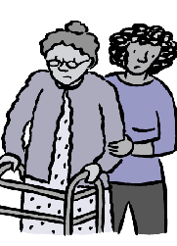
Fall Prevention – Role of Caregivers
Risk factors for falls: Age, mobility issues.
Preventive Strategies:
Ensure proper patient positioning & safe mobility
Use grab bars, anti-slip footwear & wheelchairs
Adhere to rehabilitation regimen

Slide 16
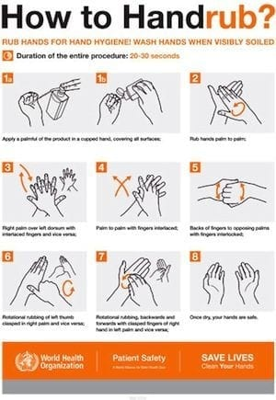
Infection Control & Hygiene Measures
Hand hygiene protocols for caregivers & patients
Proper biomedical waste disposal & cleaning procedures
Recognizing early signs of infections (fever, redness, swelling)
Preventing hospital-acquired infections (HAIs)

Slide 17
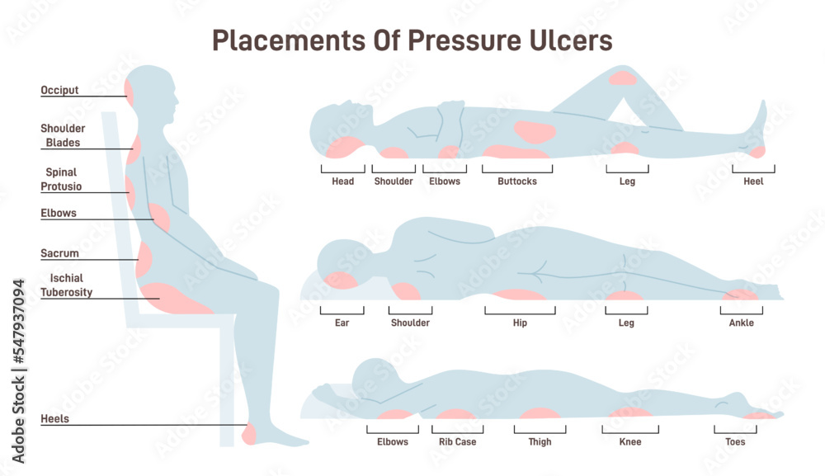
Preventing Pressure Sores in Bedridden Patients
Regular repositioning
Every 2 hours for bed-bound patients
Use of air mattresses & Cushions.
Skin care & early detection of pressure ulcers
Proper Nutrition & hydration.

Slide 18
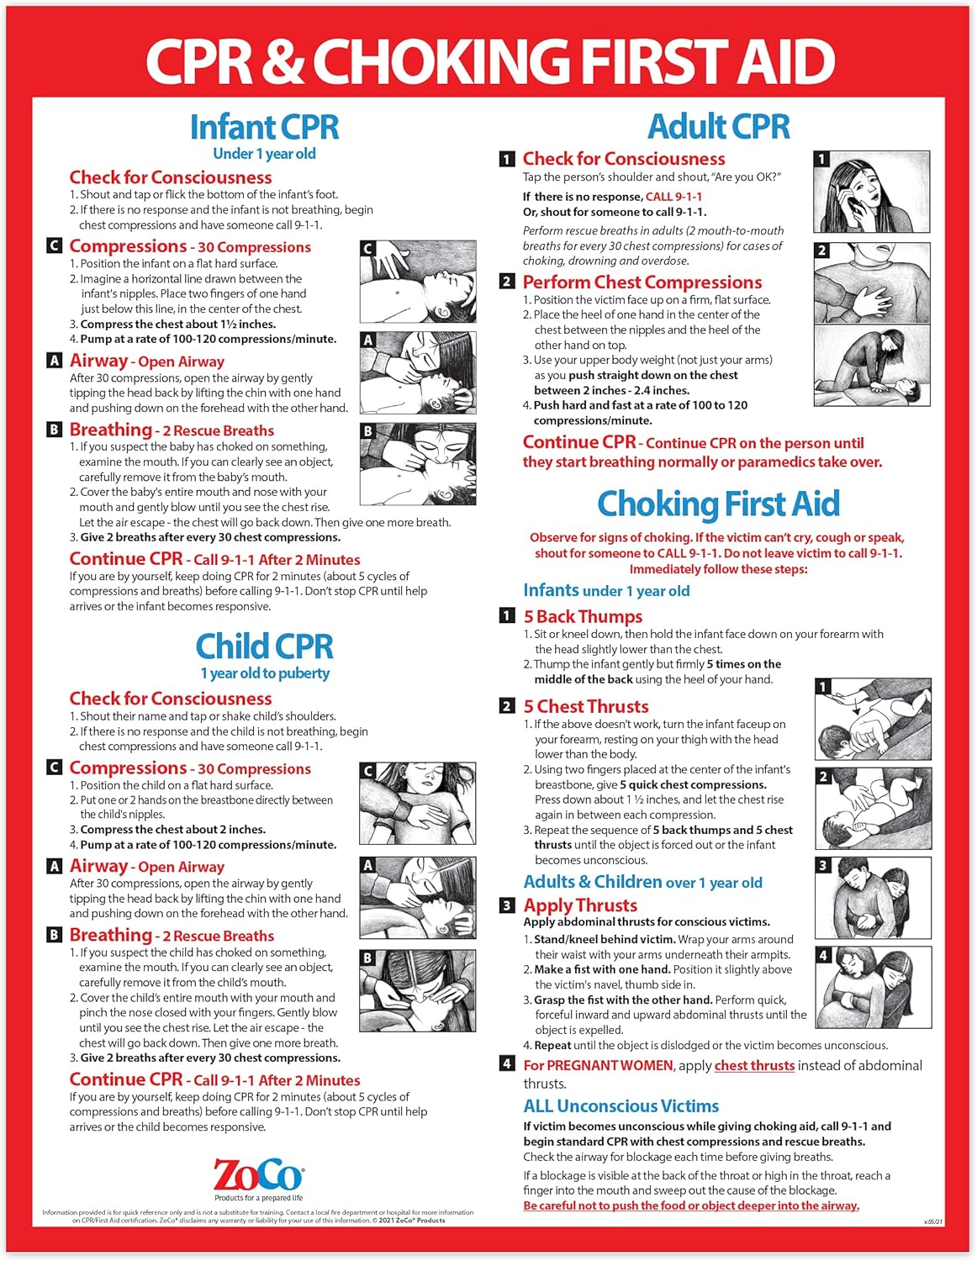
Emergency Preparedness & First Aid
Handling choking, burns and fainting incidents.
Basic CPR techniques for caregivers.
Emergency response measures for sudden patient deterioration

Slide 19

Call to Action – What Can Patients & Caregivers Do?
Speak up, report safety concerns.
Follow hygiene & medication safety.
Encourage transparency & informed decisions.

Slide 20

Redressal Mechanism – Reporting Patient Safety Concerns
Healthcare facilities must have a dedicated grievance system
Patients have the right to fair & prompt complaint hearings
Escalation to government health authorities (NABH, MoHFW) if unresolved

Slide 21
Building a Patient Safety Culture (P4PSI)
Encouraging
Encouraging hospitals to be patient-centric.
Establishing
Establishing patient safety networks.
Collaborating
Collaborating with medical institutions for training.

Slide 22
Conclusion
Patient Safety is Everyone’s Responsibility.
Empowered Patients & Caregivers = Safer Healthcare System.
Ensuring dignity, safety, and well-being for all.

Slide 23


